Slide 1
JavaScript Tutorial
Keyword, data Types, Comment
Tanvir Ahmed

Slide 2
Keyword→
1
Keywords are special words that have a special meanings.
Example : break, case, catch, continue, debugger, default, delete, do, else, finally, for, function, if, in, instance of, new, return, switch, this, throw, try, type of, variable, void, while, with.

Slide 3
Data Types→
2
String
Number
Boolean
Objects
“Tanvir Ahmed” or ‘Tanvir Ahmed’ (You can use double quotation or single quotation)
(123) (25647.354) It’s use without quotation and any number type.
True/false or less than/greater than.
No need to use this data for now.

Slide 4
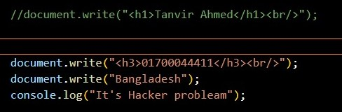
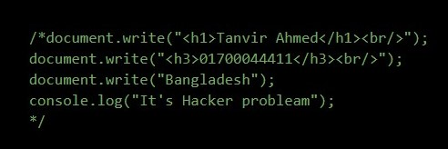
Comment→
3
Tow types of comment
Single line comment
2. Multiple line comment
Single line comment a slash is used in font of the line. (//)
Multiple line comment typically slash and star used in font of line and end of line. font(/*) end(*/)

Slide 5
Variable→
4
Variable names can only contain letters, numbers, underscore or dollar signs. (A-Z, a-z, 0-9, (_), ($)
Variable names cannot contain space.
Reserved words ( like JavaScript keyword ) cannot be used as names.
Variable names are case-sensitive.

